Slide 1
Random Forest

Slide 2
Random Forest is a popular machine learning algorithm that belongs to the supervised learning technique.
It can be used for both Classification and Regression problems in ML.
It is based on the concept of ensemble learning, which is a process of combining multiple classifiers to solve a complex problem and to improve the performance of the model.

Slide 3
Random Forest is a classifier that contains a number of decision trees on various subsets of the given dataset and takes the average to improve the predictive accuracy of that dataset."
Instead of relying on one decision tree, the random forest takes the prediction from each tree and based on the majority votes of predictions, and it predicts the final output.
The greater number of trees in the forest leads to higher accuracy and prevents the problem of overfitting.

Slide 4
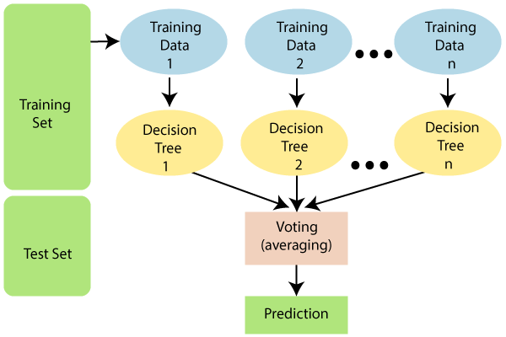

Slide 5
Random Forest works in two-phase, first is to create the random forest by combining N decision tree, and second is to make predictions for each tree created in the first phase.

Slide 6
The Working process can be explained in the below steps and diagram:
Step-1: Select random K data points from the training set.
Step-2: Build the decision trees associated with the selected data points (Subsets).
Step-3: Choose the number N for decision trees that you want to build.
Step-4: Repeat Step 1 & 2.
Step-5: For new data points, find the predictions of each decision tree, and assign the new data points to the category that wins the majority votes.

Slide 7
Example: Suppose there is a dataset that contains multiple fruit images.
So, this dataset is given to the Random forest classifier.
The dataset is divided into subsets and given to each decision tree.
During the training phase, each decision tree produces a prediction result, and when a new data point occurs, then based on the majority of results, the Random Forest classifier predicts the final decision. Consider the below image:

Slide 8
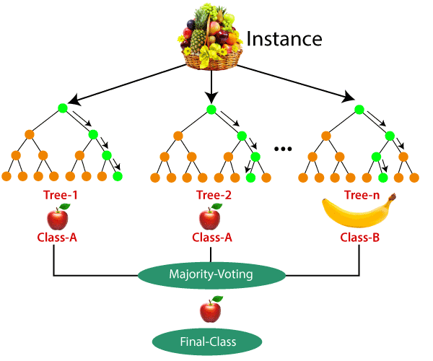

Slide 9
Exercise 1
Use random forest classifier to classify digit dataset.

Slide 10
Exercise 2
Use famous iris flower dataset from sklearn.datasets to predict flower species using random forest classifier.
Measure prediction score using default n_estimators (10)
Now fine tune your model by changing number of trees in your classifer and tell what best score you can get using how many trees.

